Slide 1
Excel Final Assessment - Batch -4
Name : Prabu T
Emp ID: 4295

Slide 2
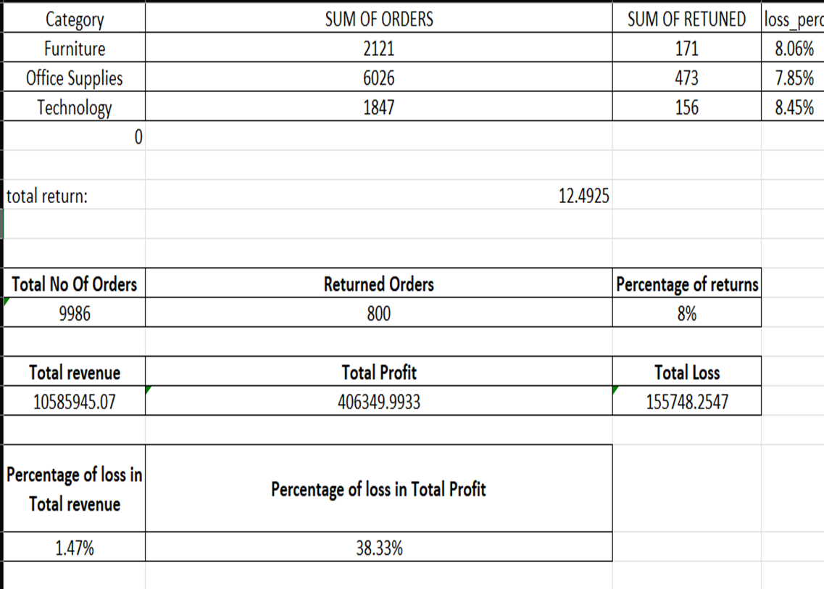
Task 1
Inference :
Return of orders should be analysed
Insights :
Using pivot table returned orders has been analysed

Slide 3
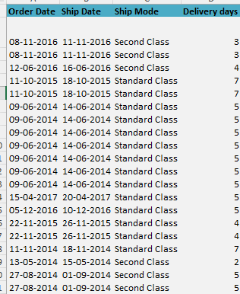
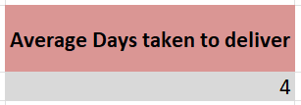
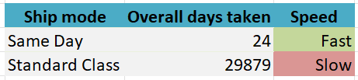
Task 2-Shipping Efficiency
Insights :
Using Abs(shipmentdate,orderdate) able to find no of days taken to shipment then using Average(days_for_shipment) gives output of 4 days .
Using pivot table and filters able the find overall days taken by each shipment mode . From those insights we able to find that Same Day mode is Fast and Standard Mode is slow
Inference :
To find average days taken to shipment.
To find which shipmode is slow and which fast

Slide 4
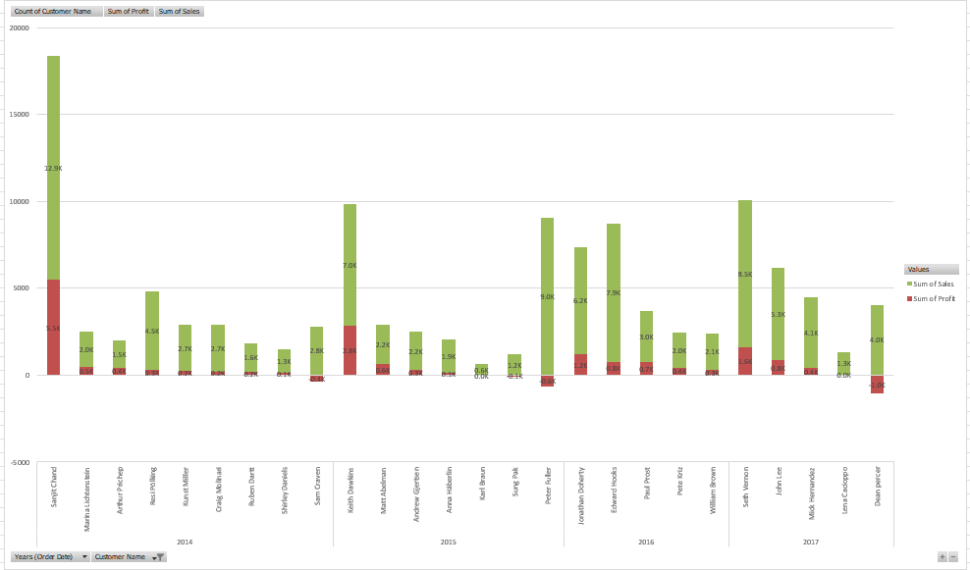
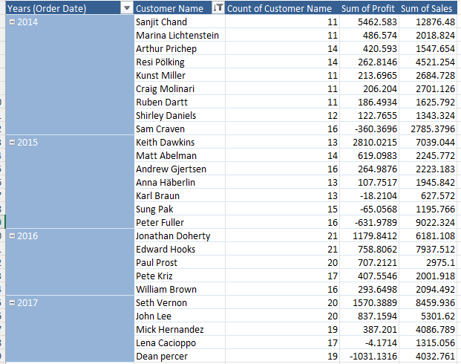
Task 3-Customer Segemntation
Insights :
Using pivot table segmented customers based on year wise no of times customers did sales, Sum of profit from each customers .
In the graph green colour is Sales and Red colour is profit . For Easy segmentation taken top3 customers based on year, sales ,profit
Inference :
To segement customers based on sales, profit,no of frquency

Slide 5
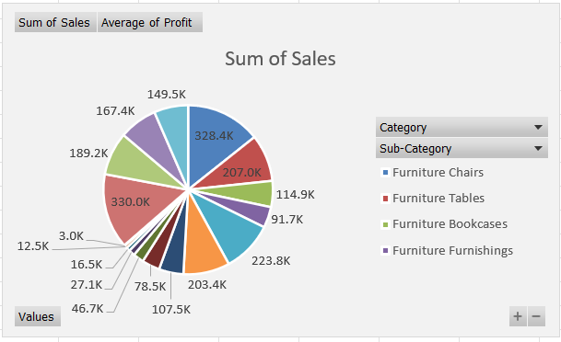
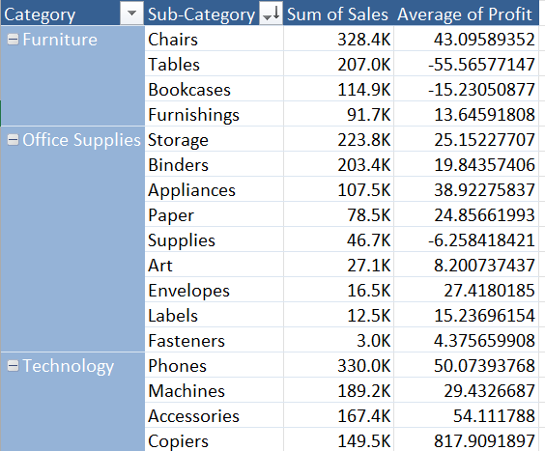
Task 4
Insights :
Using pivot table segmented category and sub category wise products and calculated their total sales and average profit
Inference :
Product Performance

Slide 6
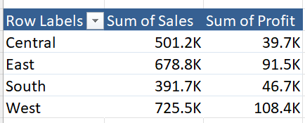
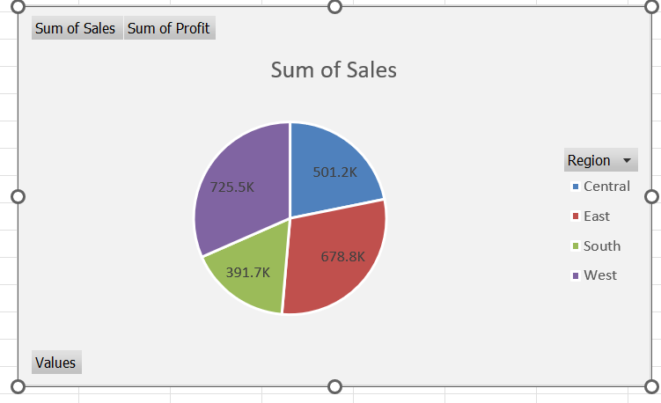
Task 5
Inference :
Insights :
Region wise Sum of sales and profit

Slide 7
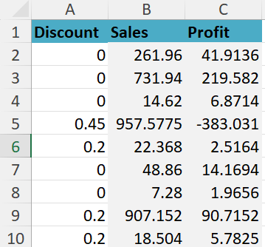
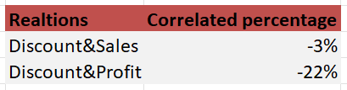
Task 6-Discount Analysis
Correlation:
Insights :
From the calculated correlation percentage we can say that if discount increases there is drop in sales by -3% and profit by -22% .
Formula proposed :
Correl(Discount,Sales)
Correl(Discount,Profit)
Inference :
To find the correlation between discount and Sales and between discount and Profit

Slide 8
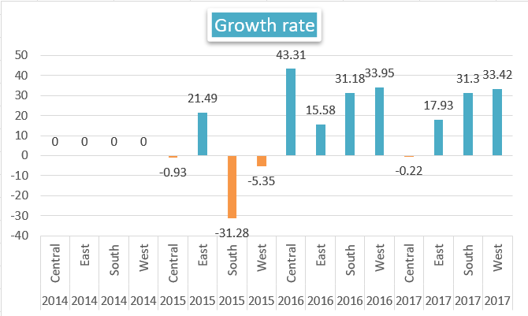
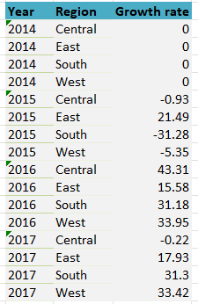
Task 7-Market Expansion
Inference :
To find the growth or low saturation of the sales based on region
Formula proposed:
((Current Year Value-Previous Year Value)/Previous Year Value)*100
Insights :
From the growth analysis we able to see that the Growth rate is increased on major years and regions.
Blue -> growth is increased compared to previous year on that region
Orange-> growth is decreased compared to previous year on that region
Insights: First Two years there is no growth(central, south, west) then it slowly increased on next 2 years, So We can expand market all regions except Central as it have low rate on prev ious year

Slide 9
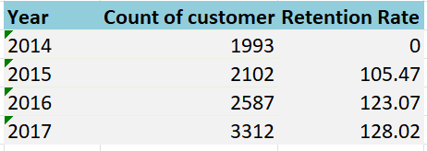
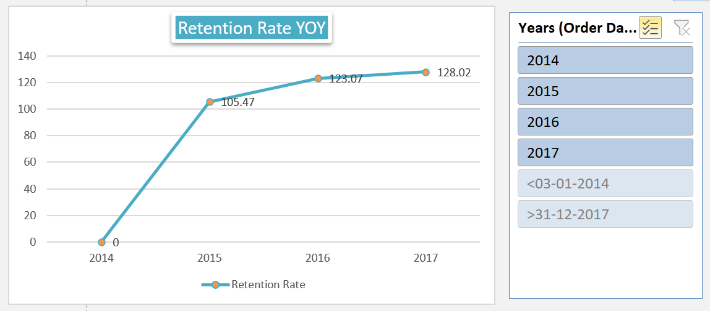
Task 8
Inference :
To find the retention rate of customers Year Over Year
Formula Proposed:
Retention_rate = (Current_year_value/Previous_year_value)*100
Insights :
From the Retention analysis we able to see that the retention rate is keep on increasing over year.
Customers have been ordering repeatedly over year as we able to see more than 100% retention rate over year

Slide 10
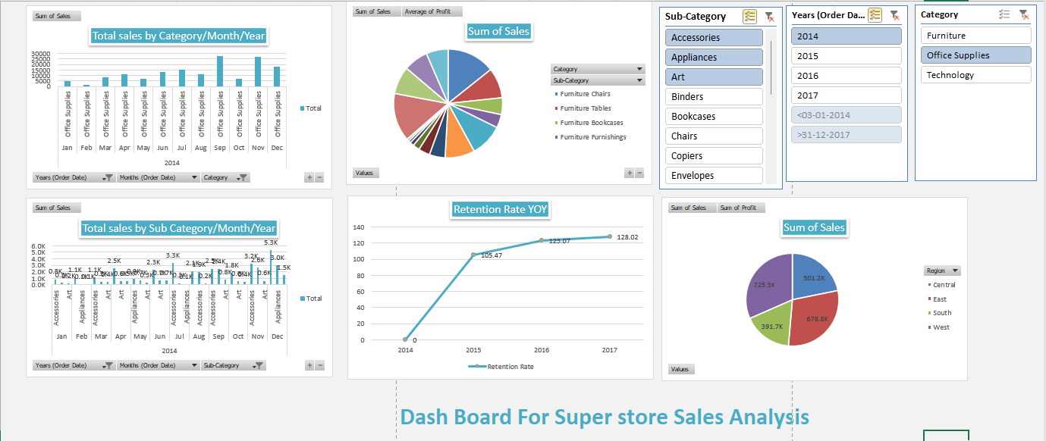
Task 9 - Dashboard
Inference :
Insights :

Slide 11
Task 9 - Dashboard
Inference :
To CreateDashBoard for Super store Sales Analysis
Insights :
Category _subcategory wise graph
Region wise graph
Customer wise Graph
Major sales and profit has been analysed based on month year using slicers

Slide 12
Thank You
max growth
Name : Prabu T
Emp ID : 4295

